Slide 1
LOGIC Paradigm
Heuristics
Inference Engine
Forward and Backward chaining

Slide 2
Heuristics
A rule of thumb often based on experience. It can result in one or more possible solutions.
Expert systems use what is called fuzzy logic, that is they make decision based on the probability of a decision being true. If a solution is 90% true then an expert or AI system will make the decision based on this probability. This allows AI to make decisions when the results are not true or false.

Slide 3
Inference engine
The control mechanism that applies knowledge, contained in knowledge base to resolve goals. The result being fulfilment or failure of a goal.
Goal – A query that can result in either being fulfilled ie True or not ie False.

Slide 4
Forward and Backward chaining
These are the methods of resolving a goal based on the facts and rules supplied.

Slide 5
Forward chaining
Start from the beginning of the knowledge base and appliy the rules and facts to arrive at a conclusion.
E.g.
Jim is doing SDD
SDD is part of the HSC
Therefore Jim is doing the HSC

Slide 6
Backward chaining
Backward chaining starts with the goal and then works backwards to try and prove the validity of each statement
E.g.
Jim is doing the HSC. <- search for facts and rules about Jim
Jim is doing SDD. <- search for facts and rules about SDD

Slide 7
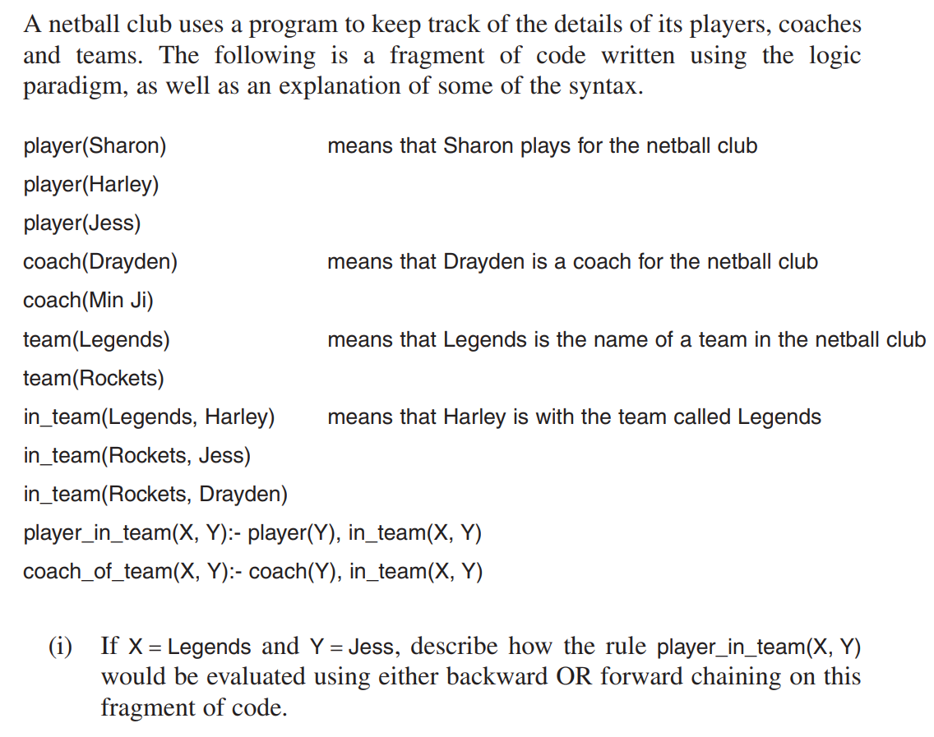
Backward chaining
The program would look at the rule, player_in_team(Legends, Jess), then try to locate a fact, player(Jess), which would be found and a fact, in_team(Legends, Jess), which would not be found and infer that it is false.
Forward chaining
The program would search the facts to find player(Jess), in_team(Legends, Harley) and in_team(Rockets, Jess) which could not be used to support player_in_team(Legends, Jess):- player (Jess), in_team(legends, Jess) and would evaluate X to be false.

